Slide 1
Toward Consistent, Usable Security Risk Assessment of Medical Devices
Penny Chase and Steve Christey Coley
The MITRE Corporation
June 3, 2016
Approved for Public Release; Distribution Unlimited 16-1984

Slide 2


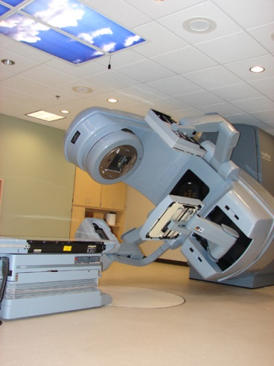

(In)security of Medical Devices
Medical devices increasingly rely upon computers, software, and networking
Medical devices often incorporate third-party software, such as operating systems for controller workstations, real time operating systems, databases, middleware, remote access
Medical devices are subject to regulation, which can impact the ability to patch and reconfigure, leaving devices running old, vulnerable software
Clinical trials are small, so many flaws aren’t discovered until device is on the market
Few manufacturers incorporate security testing

Slide 3
FDA and Device Security
Vision: To foster a community-driven collaborative environment for information sharing and for development of a shared risk-assessment framework to enhance patient safety by mitigating medical device cybersecurity risk
MITRE is helping FDA shape and implement this vision
Spurred by
2013 disclosure of medical device vulnerabilities
EO 13636 and PDD 21
Issued new pre-market and post-market cybersecurity medical device guidance
Convened the stakeholder community in workshops held in Oct 2014 and Jan 2016
Complete archives are online
Post Market Surveillance
Stake Holder Collaboration
Device Industry
Healthcare Organizations
Federal Partners
Researchers & Experts
Regulatory Clarity
Premarket expectations
Post market expectations
Enable a platform for maintaining Cybersecurity Awareness – Intentional and unintentional threats

Slide 4

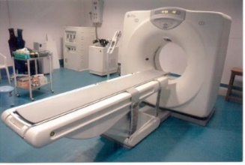


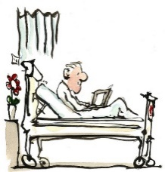

Problem: Different Perspectives of Vulnerabilities and their Severity
Vulnerability Researcher
This is bad and you have to fix it!
Device Manufacturer
Do I need to patch it now or can I wait for the next upgrade?
Healthcare Provider
Are there compensating controls or do I have to unplug it from the net?
Patient
Should I refuse treatment with this device?
FDA
Do we need to take action?

Slide 5
The Delicate Balance of Safety, Security, and Privacy
“Everything is a priority”
Varying risks to patient, device, clinical environment
Different regulatory requirements
Different prioritization depending on context of risk assessment
Each can interfere with the other
Don’t want anti-virus to fire during surgery
Security can erode privacy
Our focus: safety and security
Security
Safety
Privacy

Slide 6
Real-World Vulnerabilities and Scoring Challenges
Can be difficult to determine safety impact of a technical finding
Safety regulations already require separation and indirect defense-in-depth
Fail-safe operations
Vulnerable applications might not directly interact with physical actions
Depends on the functionality and work/data flow
Traditional information technology (IT) often prioritizes integrity and confidentiality over availability
For patient safety, availability is often extremely important
“You can’t reboot a patient”
The clinical environment varies widely

Slide 7
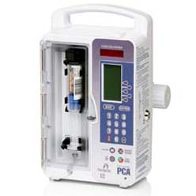
Example: Hospira LifeCare PCA Infusion Pump
Technical vulnerability(ies)
Remote telnet root access without password
CVSSv2: 10.0 (ICS-CERT)
Healthcare impact
Change drug libraries, including min/max allowed dosage
(unproven?) change actual dosage delivered
Defense-in-depth:
Human still needs to manually confirm dosage change
Environmental considerations
Pump may be on separate, “trusted” network
The vulnerable interface might not even be in use
Scoring implications
In a hospital performing due diligence, risk may be minimal
References
https://ics-cert.us-cert.gov/advisories/ICSA-15-125-01B
FDA notice for Symbiq model: http://www.fda.gov/MedicalDevices/Safety/AlertsandNotices/ucm456815.htm
Notes:
Image from: https://www.hospira.com/en/products_and_services/infusion_pumps/Lifecare

Slide 8

BD/CareFusion Pyxis SupplyStation (Drug Cabinet)
Not a regulated medical device, but important to the hospital
Technical vulnerability: use of vulnerable 3rd-party components
Healthcare impact
Unspecified; “compromise” the cabinet
Open drug cabinet, steal drugs
Defense-in-depth
Manual keys can be used to open cabinet
Environmental considerations
Cabinet typically in physically-secured environment
May be on isolated networks
Scoring implications
CVSS v3 might be a 10.0
No direct risk to patient safety
… but, delayed delivery of care possible?
References
https://ics-cert.us-cert.gov/advisories/ICSMA-16-089-01

Slide 9
High-Level Impacts in a Clinical Setting
Prevent, modify, or delay:
Therapy
Diagnosis
Monitoring and alerting
Too much, too little, too fast, too slow, too early, too late, or not at all
Reduce efficiency (more manual work)
Pivot to the rest of the network
Privacy loss
Financial loss – billing, reimbursement
Reputation damage
Loss of faith in devices
Notes:
Image from:
http://www.carefusion.com/our-products/medication-and-supply-management/medication-and-supply-management-technologies/pyxis-supply-technologies/pyxis-supplystation-system

Slide 10
Environment Matters
The raw, base CVSS score of a vulnerability has no relationship to the vulnerability’s actual impact on patient safety.

Slide 11
Desired Features of a Health Care Scoring Method
Minimal complexity
Usable by practitioners
Accepted by diverse stakeholders
Manufacturers, hospital, security researchers, patients, regulators
Flexible for different clinical environments
Flexible for different device classes
Repeatable (different people come up with same score)
Validated
Provide common “language” for centering discussion and keeping disagreements focused

Slide 12
Other Risk-Related Metrics and Analysis Frameworks
Hazard analysis
Pro: focused on safety; well-established; well-known to manufacturers
Con: unknown to researchers; does not consider sentient, adaptive attacker
CVSS v2
Pro: widely adopted and validated
Con: environmental adjustments have minimum effect on score; focused on the “box”
CVSS v3
Pro: environmental adjustments support more realistic scoring modifications
Con: not yet widely adopted; more subject to abuse and inconsistency?
CWSS (Common Weakness Scoring System)
Pro: explicitly accounts for presence of intrinsic and extrinsic controls
Con: heavy developer focus; less active use; more complex than CVSS
FAIR
Pro: Heavy adoption by finance industry
Con: Proprietary

Slide 13
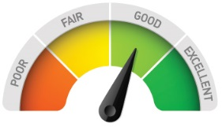
Common Vulnerability Scoring System (CVSS)
Base Metric Group
Temporal Metric Group
Environmental Metric Group
Access Vector
Confidentiality Impact
Exploitability
Collateral Damage Potential
Confidentiality Requirement
Access Complexity
Integrity Impact
Remediation Level
Target Distribution
Integrity Requirement
Authentication
Availability Impact
Report Confidence
Availability Requirement
CVSS is an open framework developed by the Forum of Incident Response and Security Teams (FIRST) for communicating the characteristics and severity of software vulnerabilities
The Base metric group represents the intrinsic qualities of a vulnerability
The Temporal metric group reflects the characteristics of a vulnerability that change over time
The Environmental metric group represents the characteristics of a vulnerability that are unique to a user's environment.
Typically only the Base score is computed and often sensationalizes medical device vulnerabilities by ignoring the clinical environment

Slide 14



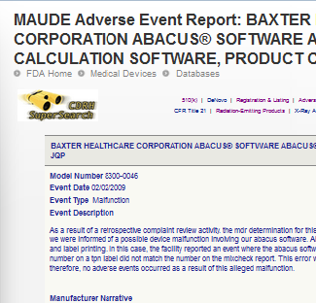
Adapt CVSS for Healthcare
Temporal
Metric Group
Base Metric Group
Environmental Metric Group
Access Vector
Confidentiality Impact
Exploitability
Collateral Damage Potential
Confidentiality Requirement
Access Complexity
Integrity Impact
Remediation Level
Target Distribution
Integrity Requirement
Authentication
Availability Impact
Report Confidence
Availability Requirement
∆ Scoring
∆ Exploitability
Healthcare threats
Collaborate with health care delivery organizations
Information Sharing and Analysis Organization
Commercial feeds and reports
∆ Impact
Compensating controls
Manufacturer’s recommendations
Hospital’s best practices
Adverse events
Apply natural language processing to extract symptoms of flaws with potential safety impact

Slide 15
CVSS v 3.0
Base Score
Attack Vector Scope
Attack Complexity Confidentiality
Privileges Required Integrity
User Interaction Availability
Temporal Score
Exploit Code Maturity
Remediation Level
Report Confidence
Environmental Score
Confidentiality Requirement
Integrity Requirement
Availability Requirement
Modified Base Score Components

Slide 16
CWSS and CWRAF
The Common Weakness Scoring System (CWSS) provides a mechanism for prioritizing software weaknesses in a consistent, flexible, open manner
The Common Weakness Risk Assessment Framework (CWRAF) enables CWSS to capture business importance through vignettes
Domains
Base Finding Metric Group
Chemical
Energy
E-voting
Technical Impact
Internal Control Effectiveness
Acquired Privilege
Finding Confidence
Technology Groups
Acquired Privilege Layer
Web Apps
Embedded Devices
Control Systems
Attack Surface Metric Group
Required Privilege
Authentication Strength
Required Privilege Layer
Level of Interaction
Business Value Context
Access Vector
Deployment Scope
Vignettes
SCADA HMI
Smart Grid House Meter
Financial loss, privacy violation
Environmental Metric Group
Business Impact
Likelihood of Exploit
10: Code exec
6: Read memory
3: Crash
Likelihood of Discovery
External Control Effectiveness
Prevalence
Technical Impact Score

Slide 17
CWRAF - Business Value Context (BVC)
Identifies critical assets and security concerns
Links Technical Impacts with business implications
More fine-grained model than the CIA Triad
CWE Technical Impacts
Modify data
Read data
DoS: Unreliable execution
DoS: Resource consumption
5. Execute unauthorized code or commands
6. Gain privileges / assume identity
7. Bypass protection mechanism
8. Hide activities

Slide 18
Simplified Technical Impact Scorecard - Web-based Shopping Cart Vignette
Technical Impact | Weight | Explanation
Modify data | 8 | Modify or delete customer order status and pricing, contact information, inventory tracking, customer credit card numbers, cryptographic keys and passwords (plaintext and encrypted).
Read data | 5 | Read customer credit card numbers, customer credit card numbers, order status, cryptographic keys and passwords (plaintext and unencrypted).
DoS: unreliable execution | 4 | Customers cannot reach site or experience delays in reaching site; delays in order placement and resulting financial loss.
DoS: resource consumption | 4 | Customers cannot reach site or experience delays in reaching site; delays in order placement and resulting financial loss.
Execute code or commands | 10 | … everything ☹
Gain privileges / assume identity | 6 | Customers can see or modify other customers’ orders
Bypass protection mechanism | 6
Hide activities | 2

Slide 19
Notional Technical Impact Scorecard – Simplified (BVC: physical safety, ignoring privacy-related regulations)
Technical Impact | Weight | Explanation
Modify data | 8
Read data | 0
DoS: unreliable execution | 2
DoS: resource consumption | 2
Execute code or commands | 10
Gain privileges / assume identity | 6
Bypass protection mechanism | 6
Hide activities | 2

Slide 20
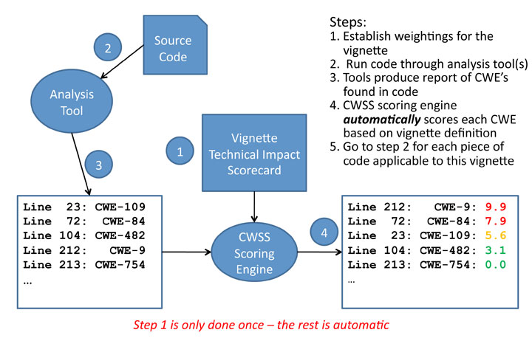
Scoring Weaknesses Discovered in Code using CWSS

Slide 21


Leverage CWSS & CWRAF to Generate CVSS Environmental Score
Generate “CWSS” Vector
Environmental Score
Confidentiality Requirement
Integrity Requirement
Availability Requirement
Modified Attack Vector
Modified Attack Complexity
Modified Privileges Required
Modified User Interaction
Modified Scope
Modified Confidentiality
Modified Integrity
Modified Availability
Environmental
Score
CVE Assigned
Vulnerability Discovered
Business Value Context
Technical Impact Scorecard
Vignettes
(HDO X Device Type)

Slide 22
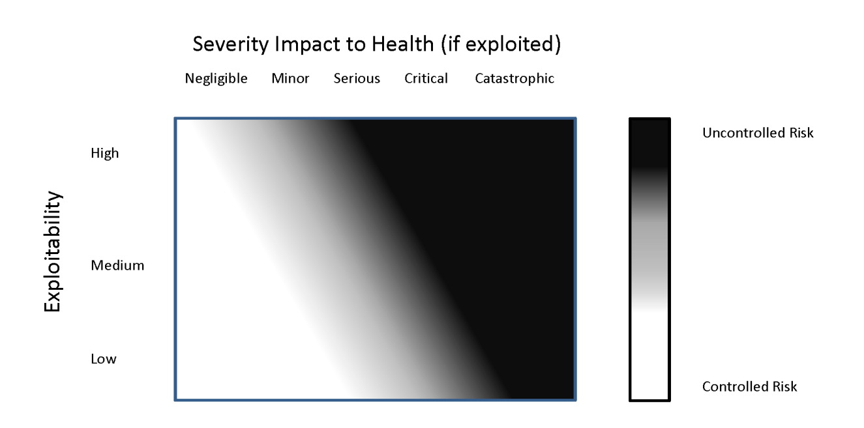
Medical Device Cybersecurity Risk Management (from DRAFT Postmarket Guidance)
Assessing Exploitability of the Cybersecurity Vulnerability
Assessing Severity Impact to Health
Evaluation of Risk to Essential Clinical Performance

Slide 23
Map to Essential Clinical Performance
Modify data
Read data
DoS: unreliable execution
DoS: resource consumption
Execute unauthorized code or commands
Gain privileges / assume identity
Bypass protection mechanism
Hide activities
Control Action
Not providing causes hazard
Providing causes hazard
Incorrect timing/order
Stopped too soon/Applied too long
Negligible
Minor
Serious
Critical
Catastrophic
Technical Impacts
Hazards Analysis
(e.g., STPA)
Severity Impact to Health (FDA Post-Market Guidance)
Attack vector
Attack complexity
User interaction
Deployment scope
Maturity of exploit code
Low
Medium
High
CVSS and CWSS elements
Exploitability
Internal control effectiveness
Authentication strength
External control effectiveness
Controlled
Uncontrolled
CWSS elements
Risk to ECP Controlled?

Slide 24
Some of the challenges/questions
What’s the right level of abstraction for device classes?
Important for scalability
What’s the right level of abstraction for vulnerabilities?
Also important for scalability
CWE taxonomy? NIST’s vulnerability taxonomy?
How do we handle multiple business value contexts, e.g., HIPAA compliance and patient safety?
Multiple vignettes?
Is computing CVSS environmental score sufficient, or will we need to add elements to the CVSS vector to better reflect the healthcare environment?

Slide 25
Another Challenge: The “Bill of Materials” and Scoring of 3rd-Party Components
Health care providers want manufacturers to provide a bill of materials for their devices
“Am I vulnerable to [popular, scary vulnerability]?”
As of May 2016, only Royal Philips has publicly stated they will do this
3rd-party libraries are often scored in isolation
Worst-case assessment
3rd-party applications might not have same attack surface
e.g. use of browser without ability to make remote connections
If “only” a DoS but prevents device operation – bad
If root/admin privileges but only to asset-management component, with strong separation from device functionality – no biggie
If affected API function is unreachable – no vulnerability (or very low risk)

Slide 26
Healthcare CVSS Working Group – as of May 17, 2016
Approximately a dozen members
Kickoff telecon held on May 11, 2016
“Whole of Community” Approach with diverse stakeholders
Manufacturers
Health care providers
Security researchers / consultants
Academia
Government agencies

Slide 27
Work Plan
Initial steps
Identified and invited small team for initial development
Manufacturers, HDOs, cybersecurity researchers, NIST, ICS-CERT
Held kick-off telecon May 11
Next steps
Draft initial vignette for infusion pump 4-6 weeks after kick-off
Get feedback from broader community
Iterate…
Later steps
Additional device areas
Consider validation of algorithm as Medical Device Development Tool (MDDT)

Slide 28
Questions?
pc@mitre.org (Penny)
coley@mitre.org (Steve)

Slide 29
BACKUP / DETAIL SLIDES

Slide 30
Abbreviations
CIA – Confidentiality, Integrity, Availability
CVE – Common Vulnerabilities and Exposures
CVSS – Common Vulnerability Scoring System
CWE – Common Weakness Enumeration
CWSS – Common Weakness Scoring System
CWRAF – Common Weakness Risk Assessment Framework
ECP – Essential Clinical Performance
ICS-CERT – Industrial Control Systems Computer Emergenct Response Team
STPA – Systems-Theoretic Process Analysis

Slide 31
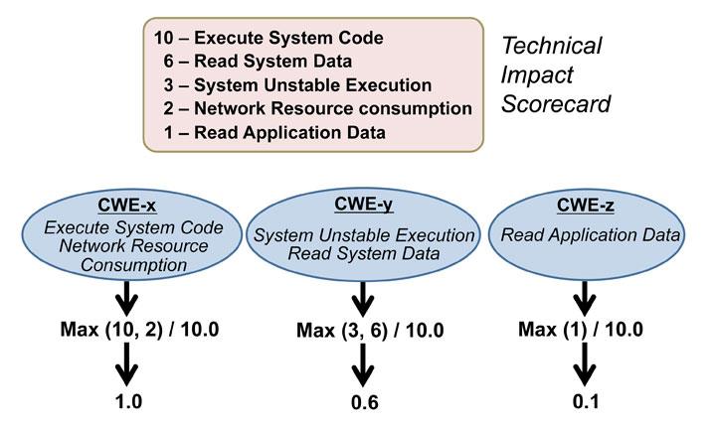
Calculating CWSS Impact Weights

Slide 32
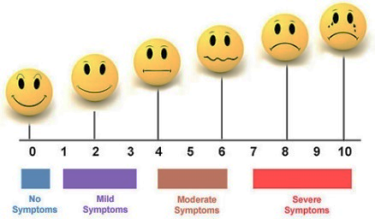

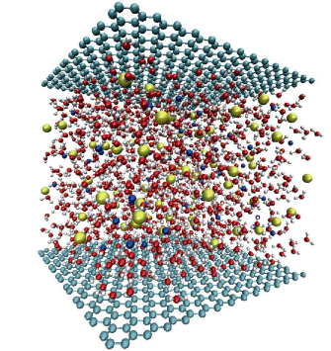
… and qualify it as a Medical Device Development Tool (MDDT)
MDDTs are scientifically validated tools that can “facilitate the scientific evaluation and assessment of a medical device by providing a more efficient and predictable means for collecting the necessary information to make regulatory assessments.”
MDDTs are scientifically validated tools that can “facilitate the scientific evaluation and assessment of a medical device by providing a more efficient and predictable means for collecting the necessary information to make regulatory assessments.”
Three tool types
Clinical outcome assessment
Biomarker test
Nonclinical assessment model
Qualification package
Description of the tool
Context of use
Strength of evidence
Assessment of advantage and disadvantages of qualifying the tool

Slide 33
Relation to FDA Work
Developing the context of use
General framework with specialized vignettes
Initial focus on infusion pumps
Use in post-market setting when vulnerabilities are discovered by manufacturers or third parties
FDA and public health impact
Manufacturers and third parties have a shared framework for assessing severity of vulnerabilities
FDA and manufacturers triage vulnerabilities based on ECP
Reduce sensationalism and reassure public of device safety
Reaching out to community to develop vignettes
Small initial group drawn from device manufacturers, healthcare delivery organizations, cybersecurity researchers, ICS-CERT, FDA
Larger group for feedback
Collaboration with MDISS/NH-ISAC MDVISI effort
Evolving MDRAP to crowd source information about devices
This work can both inform the data collection and use the data to aid in analysis of technical impacts and compensating controls

Slide 34
AHRQ Patient Harm Scale
Version 1.1
Death
Severe Permanent harm
Permanent harm
Temporary harm
Additional treatment
Emotional distress or inconvenience
No harm
Version 1.2 – Temporal elements moved to a separate dimension
Death
Severe harm
Moderate harm
Mild harm
No harm
https://pso.ahrq.gov/

